Slide 1
Integrating Human Factors into Medical Device Product Development Lifecycles
Elizabeth Bononno
10Dec2021

Slide 2
Who am I?
Over 20 years in the Healthcare Industry
Siemens Healthcare for 13 years in Product Management, User Experience and Design Validation
Owner, EB-UX Consulting working with medical device companies to factor in the humans
What I love about my job = people!
I enjoy working with end users of products and those that design them to ensure the product works the way the customer would use it.

Slide 3
Agenda
What is usability engineering in medical devices?
Why is it important?
Drivers: Thought leaders, U.S. & International Standards
Medical Device users, use environments, tasks and device user interfaces
Integrating Human Factors / Usability Engineering deliverables into the product development lifecycle
Tailoring the effort

Slide 4
What is usability engineering in medical devices?
The application of knowledge about human behavior, abilities, limitations, and other characteristics of medical device users to the design of medical devices
Including mechanical and software driven user interfaces, systems, tasks, user documentation, and user training to enhance and demonstrate safe and effective use.
Human factors engineering and usability engineering can be considered to be synonymous
Notes:
Applying Human Factors and Usability Engineering to Medical Devices Guidance for Industry and Food and Drug Administration Staff. Document issued on: February 3, 2016

Slide 5
Why is it important?
According to FDA data, about a third of medical device failures that result in suboptimal treatment, injuries or deaths appear to be the result of “use errors” rather than strict manufacturing flaws.
Health News Daily, March 9, 2010
A failure to apply human factors principles is a key aspect of most adverse events in health care.
Key regulatory bodies (CE and FDA) are auditing for usability with respect to safety.
Notes:
Reports compiled by the Food and Drug Administration (FDA) indicate that as many as one-third of “device failures”
that involve use of medical devices and that result in suboptimal medical treatment, injuries, and even deaths appear
to be failures of device use rather than failure of the device itself. Multiple cases of device recalls resulting from clear cut
problems have been successfully addressed by modification of the device–user interface, the source of the
problem. It is desirable to prevent unfortunate use-related “failures” before they become part of the health care
system. AAMI/ANSI, HE-75 (Section 5.1)

Slide 6
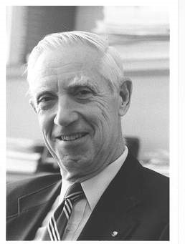
Drivers – Thought leaders
Dr. Lucian Leape – Health Policy Innovator
Pediatric Surgeon
National Patient Safety Foundation
Harvard School of Public Health
“Error in Medicine”(1994)
10 – 15% of medical cases involve Errors
50 – 66% of Errors are Preventable
“To Err is Human: Building a safer health system” (1999)
There aren’t bad people, there are bad systems.
Systems-based solutions
Collaboration, team communication, respect
Notes:
Lucian Leape is a health policy innovator who has had two careers. After graduating with honors from Harvard Medical School in 1959, he trained in general and thoracic surgery at the Massachusetts General Hospital and in the new specialty of pediatric surgery at Boston Children's Hospital. In his first academic post at the University of Kansas, his research focused on the pathophysiology of burns, gastroesophageal reflux, and the use of parenteral nutrition in infants. He became a Markle Scholar and was instrumental in the founding of the American Pediatric Surgical Association. He returned to Boston as professor and head of pediatric surgery at Tufts University Medical Center, a position he held for 13 years. He published over 100 papers and book chapters and a textbook in pediatric surgery.
In 1986, he began a new career in health policy. After a Pew fellowship at RAND, he joined the just beginning Medical Practice Study (MPS) of medical injury and became an adjunct professor at Harvard School of Public Health. With colleagues at RAND he conducted some of the early studies of overuse and underuse of cardiac procedures. When the MPS revealed the extent of preventable harm, he began a study of the causes of errors, leading to the publication in JAMA in 1994 of Error in Medicine, which called for the application of systems theory to prevent medical errors. This led ultimately to the founding of the National Patient Safety Foundation and the Institute of Medicine’s landmark publications, To Err is Human and Crossing the Quality Chasm.
His subsequent work has focused on the application of systems theory to health care, improving disclosure and apology following medical harm, and, most recently, changing medical culture to be more respectful and patient-centered. He has been honored with the American Pediatric Surgical Association’s Distinguished Service Award, the John Eisenberg Award of the Joint Commission and National Quality Forum, and the Donabedian Award of the American Public Health Association. In 2006, Modern Healthcare named him as one of the 30 people who have had the most impact on healthcare in the past 30 years. In 2007, the National Patient Safety Foundation established the Lucian Leape Institute to further strategic thinking in patient safety.

Slide 7
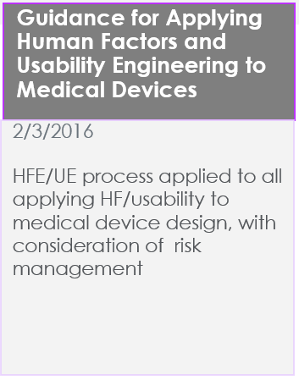
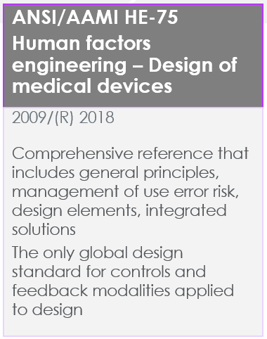
Drivers – U.S. & International Standards
Notes:
Application of Usability Engineering to Medical Devices: New since 2008: Term changes, UOUP, usability retrospectives alignment with FDA and other HFE standards
Guidance for Applying Human Factors and Usability Engineering to Medical Devices: New since 2011: Number of users for design validation, statistical analysis and rational for selection and alignment with IEC
HE75 covers general human factors engineering (HFE) principles, specific HFE principles geared towards certain user-interface attributes, and special applications of HFE

Slide 8
Drivers – Convergence of standards
Timeline of regulations between HF/UE, Risk, Quality and Design Validation
2000
2005
2010
2015
2020
IEC 62366:2007
FDA Guidance
2011
IEC 62366-1:2015
IEC 62366-2:2016
FDA Guidance
2016
HE75 2009,(R) 2013,(R) 2018
IEC 60601-1-6 &1 1:2010, 60601-1-8 Edition 2.1 2012-11
ISO 14971 2000,(R) 2007, EN2012, (R) 2019
QSR 21 CFR Part 820 1978, 1990, 1996 & ISO 13485:2003/ISO 13485:2016
Notes:
The FDA Considers the following standards for Human Factors / Usability Engineering:
FDA Guidance for Applying Human Factors and Usability Engineering to Medical Devices 2:2016
FDA guidance document to assist industry in following appropriate human factors and usability engineering processes to maximize the likelihood that new medical devices will be safe and effective for the intended users, uses and use environments.
AAMI/ANSI HE75:2009(R)2018: Human Factors Engineering – Design of Medical Devices
Comprehensive reference that includes general principles, management of use error risk, design elements, integrated solutions
The only global design standard for controls and feedback modalities applied to design
ANSI/AAMI/IEC 62366-1:2015 Medical devices – Part 1: Application of usability engineering to medical devices
HFE/UE process applied to all applying HF/usability to medical device design, with consideration of risk management
ANSI/AAMI/ISO 14971:2007/(R)2010 Medical Devices – Application of risk management to medical devices
Risk management process for medical devices
IEC 60601-1-6:2010 Medical electrical equipment – Part 1-6: General requirements for basic safety and essential performance – Collateral standard: Usability
Provides a bridge between IEC 60601-1 and ANSI/AAMI/IEC 62366IEC
60601-1-8 Edition 2.1 2012-11 Medical electrical equipment — Part 1-8: General requirements for basic safety and essential performance — Collateral Standard: General requirements, tests and guidance for alarm systems in medical electrical equipment and medical electrical systems
Design standard for alarm systems in medical electrical equipment and systems
IEC 60601-1-11:2010 Medical electrical equipment – Part 1-11: General requirements for basic safety and essential performance – Collateral Standard: Requirements for medical electrical equipment and medical electrical systems used in the home healthcare environment
Requirements for medical electrical equipment used in non-clinical environments, including issues involving medical device use by lay users
In addition the process described in ISO 14971 applies to risks associated with a medical device, such as risks related to biocompatibility, data and systems security, electricity, moving parts, radiation, and usability.
Medical device manufacturers are required to comply with the Quality System regulation, 21 CFR Part 820. In particular, Section 30, Design Controls, includes requirements relevant to human factors

Slide 9
Summary - guidance for medical device HFE
The objective is to reduce safety risks.
User interface design flaws (both hardware and software) can induce use errors.
The FDA and other regulators expect medical devices to protect users from harm.
Safe devices prevent use error, or at least help users detect and correct use errors.
Use errors can be reduced through better interface design.
Creating a consistent approach to usability reduces risk.

Slide 10
Medical Device Users
Notes:
The ability of a user to operate a medical device depends on his or her personal
characteristics, including:
• Physical size, strength, and stamina,
• Physical dexterity, flexibility, and coordination,
• Sensory abilities (i.e., vision, hearing, tactile sensitivity),
• Cognitive abilities, including memory,
• Medical condition for which the device is being used,
• Comorbidities (i.e., multiple conditions or diseases),
• Literacy and language skills,
• General health status,
• Mental and emotional state,
• Level of education and health literacy relative to the medical condition involved,
• General knowledge of similar types of devices,
• Knowledge of and experience with the particular device,
• Ability to learn and adapt to a new device, and
• Willingness and motivation to learn to use a new device.

Slide 11
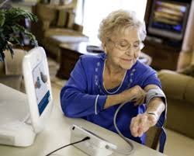
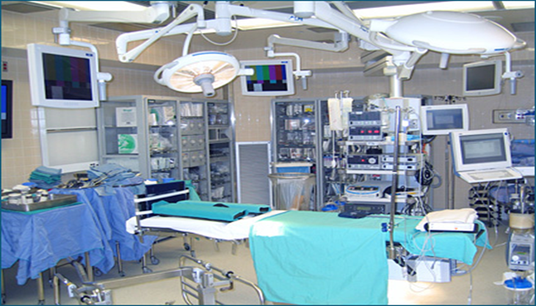
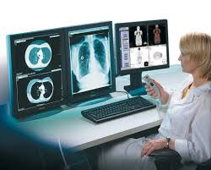
Medical Device Use Environments
Notes:
Understanding the users environment when operating the device and how it impacts the device’s use, also leads to a better understanding of risks resulting from the environment(s). Conditions could be variable.
Environmental conditions include: lighting, noise level, heat, humidity, standing, seated, in transport, emergency room, hospital vs. home use

Slide 12
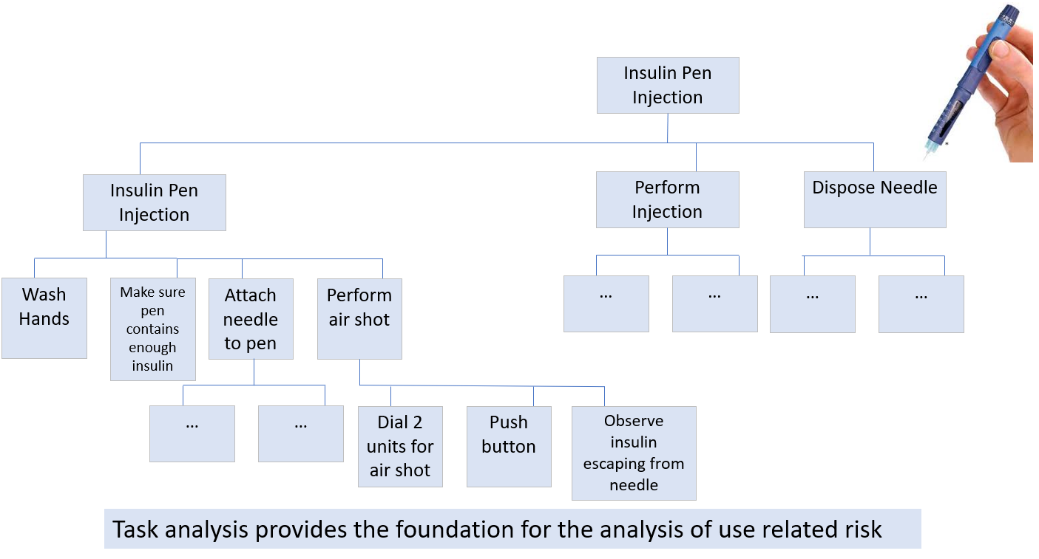
Medical Device Tasks
Identification of potential use errors
Notes:
Task analysis techniques systematically break down the device use process into discrete sequences of tasks. The tasks are then analyzed to identify the user interface components involved, the use errors that users could make and the potential results of all use errors.

Slide 13
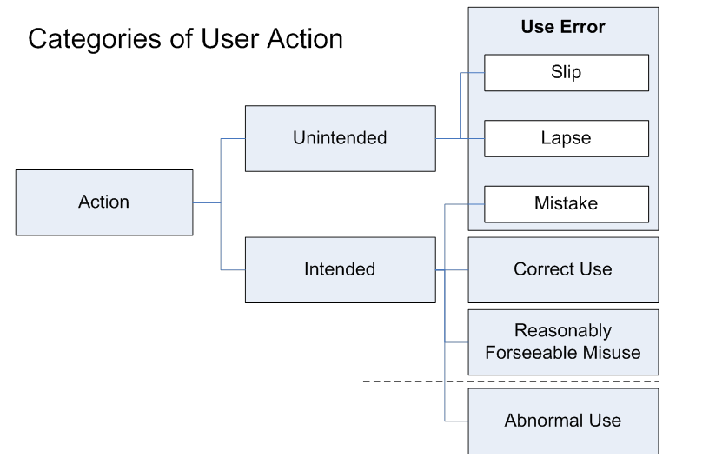
Use Errors
The device might be used in unexpected (unintended) ways.
Interactions with the device may exceed the users’ physical, perceptual, or cognitive abilities.
Device interactions do not follow the users’ expectations.
Environment degrades task performance.
Use error: "(An) act or omission of an act that results in a different medical device response than intended by the manufacturer or expected by the user.”
Notes:
Unreadable text
Display glare
Lack of critical action confirmation
Closely spaced controls
Overly complex procedures
Dependence on user memory
Breaking universal rules/convention

Slide 14
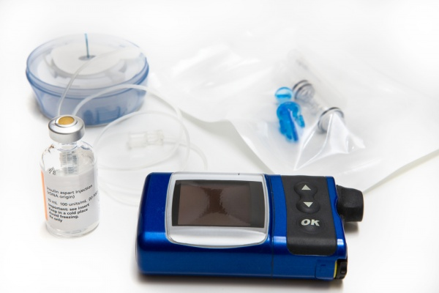
Medical Device User Interfaces
All points of interaction between the user and the device:
Insulin
Inset & tubing
Re-fillable cartridge
Insulin pump
GUI
Instructions for use
Packaging
Labeling
Training
Notes:
A device user interface includes all points of interaction between the user and the device, including all elements of the device with which the user interacts. A device user interface might be used while user setups the device (e.g., unpacking, set up, calibration), uses the device, or performs maintenance on the device (e.g., cleaning, replacing a battery, repairing parts). It includes: • The size and shape of the device (particularly a concern for hand-held and wearable devices), • Elements that provide information to the user, such as indicator lights, displays, auditory and visual alarms, • Graphic user interfaces of device software systems, • The logic of overall user-system interaction, including how, when, and in what form information (i.e., feedback) is provided to the user, • Components that the operator connects, positions, configures or manipulates, • Hardware components the user handles to control device operation such as switches, buttons, and knobs, • Components or accessories that are applied or connected to the patient, and 11 • Packaging and labeling, including operating instructions, training materials, and other materials.

Slide 15
Integrating HFE deliverables into development lifecycles
Product Development Process
Project Plans
Risk Analysis
Design
Validation Testing
Post Market Surveillance
Product
Definition
Feature Requirements
Verification Testing
Usability Engineering Process
HFE / UE Plan
Task / Use Error Analysis
Formative Testing
Summative Testing
Field Observation
Use Specification
User Interface Specification

Slide 16
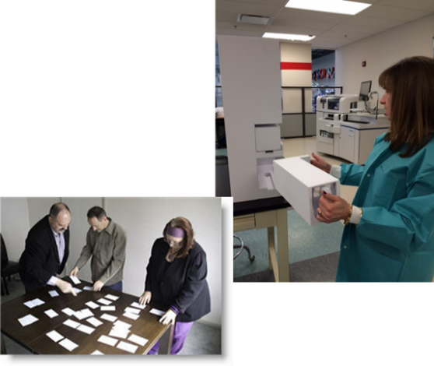
Integrating HFE deliverables by development phase
Definition |  | Feasibility | Development and Verification |  | Validation
HFE/Usability Engineering Plan HFE/Usability Engineering File | Use Specification | Task / Use Error Analysis User Interface Specification | Formative Plans | Formative Reports Summative Plan | Summative Testing & Reports HFE/UE Report
Definition
Feasibility
Verification & Validation
Information Gathering: Evaluation: Testing:
Focus Groups Heuristic Evaluation Formative Testing
Surveys/Questionnaires Task Analysis Summative Testing
Contextual Interviews Cognitive Walkthrough
Ethnographic Research Concept Testing / Modeling
Card Sorting Wire framing

Slide 17
Usability Engineering can be tailored
Based on the scope of the project, all usability engineering activities are not always needed. However, you should always consider the usability risk.
Usability engineering should be considered when:
New User Interfaces (software or hardware) are introduced
Rework / improvements are made to existing user interfaces
New usability requirements are created to test changes
Changes are made to current customer workflow
There are known issues for fielded product or like competitive devices

Slide 18
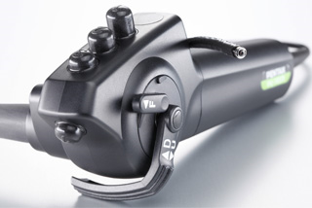
Example – Hardware re-design
Scope is it to adapt a new piece of hardware to reduce cost.
The previous design was already accompanied by a usability engineering process.
No new user interface components are planned.
No usability engineering is needed:
The assessment can be documented in the Project Plan or Marketing / Design Specification
Existing Usability Files should be amended

Slide 19
Example – Software re-design
Scope is to add several capabilities to an existing feature.
There are some changes to existing screens.
The product had not followed a usability engineering
process previously (UOUP).
Next Steps
Evaluate any potential user risk for proposed changes including:
Changes to workflow (new or existing)?
Changes to screens that add information or change the layout or navigation?
Known usability issues with the affected screens?
2. Perform a retrospective on the previous release of the product, add to the UE File.
Usability Engineering is needed on the project

Slide 20
Conclusions
Both International and U.S. standards require usability engineering for medical devices
Less operating / use errors – fewer risks to patients
Usability engineering is also good for business
People love to work with excellent tools; ones that are easy to use and support them reaching their goals efficiently and effectively
Consistent look & feel – Attributes of a high-quality product
Less training needed – reduction of training costs
Reduction of service calls / costs
Usability up
Costs down

Slide 21
Deep Dive Usability Engineering Deliverables by Product Development Phase

Slide 22
Product Definition
Definition |  | Feasibility | Development and Verification |  | Validation
HFE/Usability Engineering Plan HFE/ Usability Engineering File | Use Specification | Task / Use Error Analysis User Interface Specification | Formative Plans | Formative Testing & Reports Summative Plan | Summative Testing & Reports HFE/UE Summary Report
HFE/Usability Engineering Plan
Can be part of the overall project plan
Outlines the overall scope of planned usability work for a project as well as the broad usability goals.
References applied standards e.g., IEC 62366 will be followed
HFE/Usability Engineering File
Can be part of the overall project plan
A central repository for all documents developed supporting Usability Engineering.
Does not need to contain all the usability records and documents, but should contain references (pointers) to the location of required documentation

Slide 23
Product Definition
Definition |  | Feasibility | Development and Verification |  | Validation
HFE/Usability Engineering Plan HFE/ Usability Engineering File | Use Specification | Task / Use Error Analysis User Interface Specification | Formative Plans | Formative Testing & Reports Summative Plan | Summative Testing & Reports HFE/UE Summary Report
Use Specification
Intended medical indication
Intended Patient population
Intended part of the body or type of tissue applied to or interacted with
Intended User Profile
Intended Use Environment
Operating Principle & Device Description.
The User Interface (UI) can be described here
Training intended for users

Slide 24
Feasibility
Definition |  | Feasibility | Development and Verification |  | Validation
HFE/Usability Engineering Plan HFE/ Usability Engineering File | Use Specification | Task / Use Error Analysis User Interface Specification | Formative Plans | Formative Testing & Reports Summative Plan | Summative Testing & Reports HFE/UE Summary Report
Task / Use Error Analysis
Systematically breaks down the device use process into discrete sequences of tasks.
Tasks are then analyzed to identify the user interface components involved, the use errors that users could make and the potential results of all use errors.
Risk control measures identified are described as a User Interface Specification in the Design Input Requirement document and then translated into an appropriate Design Output thereafter.
These include:
Safety-related risks and hazards associated with the usability of a product. Reasonable foreseeable events involving the user interface that can result in a hazardous situation. Potential hazards known for existing user interfaces of like devices. Potential use errors that could cause a hazardous situation.
The issues identified can be incorporated in the overall product risk process and documentation.

Slide 25
Feasibility
Definition |  | Feasibility | Development and Verification |  | Validation
HFE/Usability Engineering Plan HFE/ Usability Engineering File | Use Specification | Task / Use Error Analysis User Interface Specification | Formative Plans | Formative Testing & Reports Summative Plan | Summative Testing & Reports HFE/UE Summary Report
User Interface Specification
Provides information about the intended use, users, and context of use of the device or software.
The most important components of the deliverable are: Testable requirements for usability verification that measure human interaction with the device and testable requirements for the usability of the primary operation functions including the criteria for determining the adequacy of risk control achieved by the UE process.
Includes: Intended: use, user profiles, patient population, type of body fluids, conditions of use and basic operating principles, sources of testable, measurable and traceable requirements including lower-level specifications that describe specific user behavior, issues derived from use related risk assessment, customer needs or known issues.

Slide 26
Testable User Interface Specification Requirements
90% of all operators shall be able to successfully resolve a sample-related error without assistance.
Operators: Defined in the Use Specification
Success Rate: Designate # per user group
Successfully Resolve:
Pass = The operator takes the correct action to address the specific condition.
The test fails if one of the following occurred:
Operator does not realize there is a problem, or an action needed
Operator is stalled for 5 minutes or more
Operator gives up after not being able to figure out what to do
Operator fixes the wrong thing

Slide 27
Re-cap – Definition and Feasibility
Task / Use Error Analysis
Use Specification
User Interface Specification
All user touch points
Potential misuse
Severity
Known usability issues
Planned usability improvements
Usability attributes of the system
Measurable behavior
Feature-level
Pass/fail criteria
Intended medical use
Operator population
Type of body fluid analyzed
Conditions of use
Primary operating functions
Frequently used features and functions

Slide 28
Verification & Validation
Definition |  | Feasibility | Development and Verification |  | Validation
HFE/Usability Engineering Plan HFE/ Usability Engineering File | Use Specification | Task / Use Error Analysis User Interface Specification | Formative Plans | Formative Testing & Reports Summative Plan | Summative Testing & Reports HFE/UE Summary Report
Formative Plans and Reports
Plan:
Performed early with simulations and earliest working prototypes
Includes: usability goals, test environment, participants, scenarios / test performed
Explores whether usability objectives are attainable, without strict acceptance criteria
Traceable to Usability Interface Specifications.
Report:
Recap of the plan
Evidence that design output matches design input
Includes recommendations for improvements and is reviewed with the development team

Slide 29
Verification & Validation
Definition |  | Feasibility | Development and Verification |  | Validation
HFE/Usability Engineering Plan HFE/ Usability Engineering File | Use Specification | Use Related Risk Assessment (URRA) User Interface Specification | Formative Plans | Formative Testing & Reports Summative Plan | Summative Testing & Reports HFE/UE Summary Report
Summative Plans and Reports
Plan:
Performed in the late stages of design
Includes: formal acceptance criteria, usability objectives for human performance, test environment (real or simulated), methods and techniques, participants (including rationale for number of participants used), dependencies, satisfaction ratings
Report:
Provides evidence that the user needs and acceptance criteria were met
Provides evidence that the device is safe and effective for use
Documents participants, recommended improvements and non-conformances

Slide 30
HFE Summary Report
Definition |  | Feasibility | Development and Verification |  | Validation
HFE/Usability Engineering Plan HFE/ Usability Engineering File | Use Specification | Use Related Risk Assessment (URRA) User Interface Specification | Formative Plans | Formative Testing & Reports Summative Plan | Summative Testing & Reports HFE/UE Summary Report
HFE/UE Summary Report
Included in a premarket submission should provide information pertaining to device use safety and effectiveness in summary form.
Discusses the safety-related HFE/UE considerations, issues, processes, resolutions, and conclusions.
The level of detail of documentation submitted should be sufficient to describe the identification, evaluation, and final assessment of all serious use-related hazards for the device
Materials used directly in the HF/UE process, including portions of risk analyses focusing on user interactions with the device and specific risk analysis processes, results and conclusions should be included

Slide 31
Post Market Surveillance
Can include:
Customer Visits
Product Health Reviews
Review of service call records, escalated customer accounts, field reports
Analyze new usability issues for safety risk
Communicate/Review with development team
Add to the product’s issue tracking system and roadmap for future releases of the product
Importance:
Address known issues related to safety
Products fielded 2008 and later need to comply with Annex C IEC62366
Retrospective documentation

